Slide 1
Condo Plus System
Jorge Rodriguez

Slide 2
Summary
The mission statement
3 key user processes
System overview

Slide 3
The Mission Statement

Slide 4
3 Key User Processes
Broadcast Announcements
Manage Facility Booking
Feature being unlocked when the user logs in

Slide 5
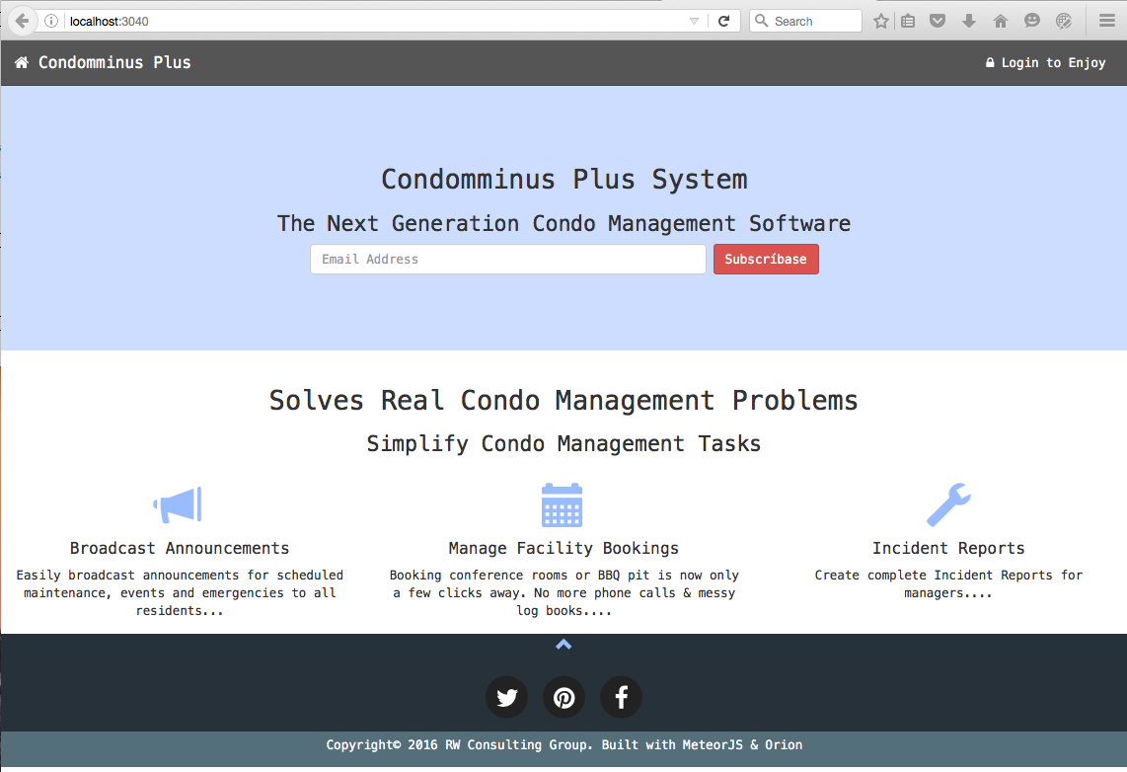
System: route /

Slide 6
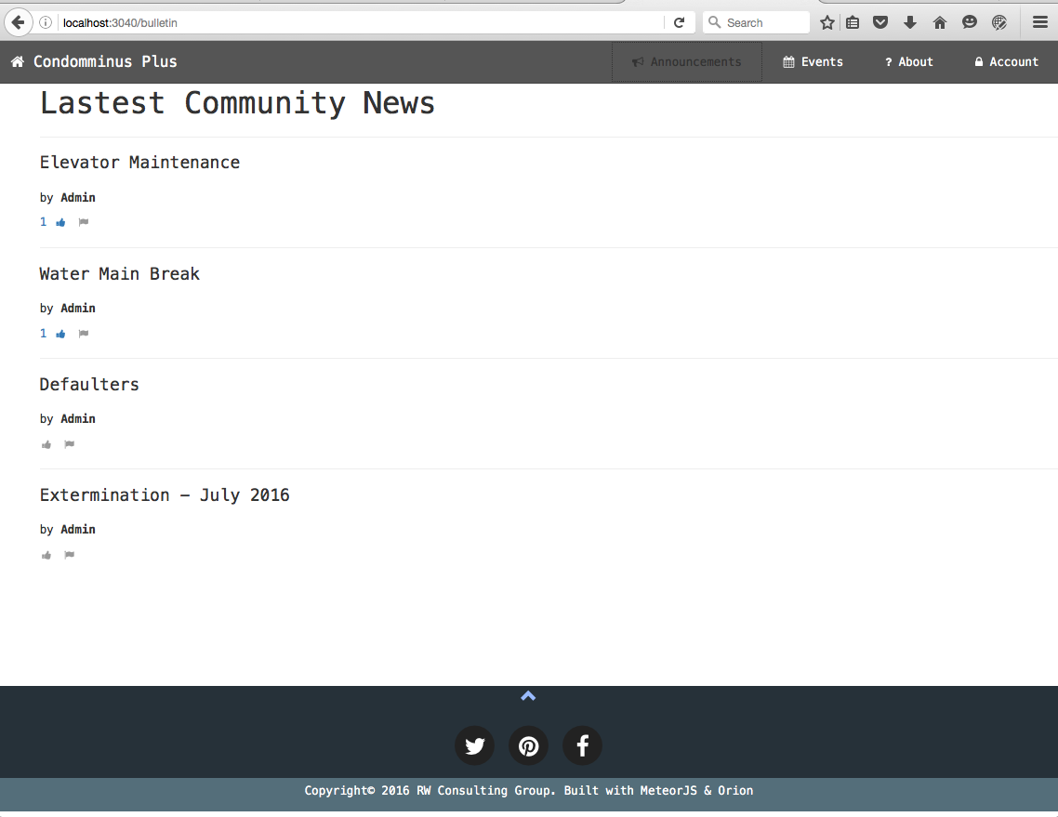
System: route /bulletin

Slide 7
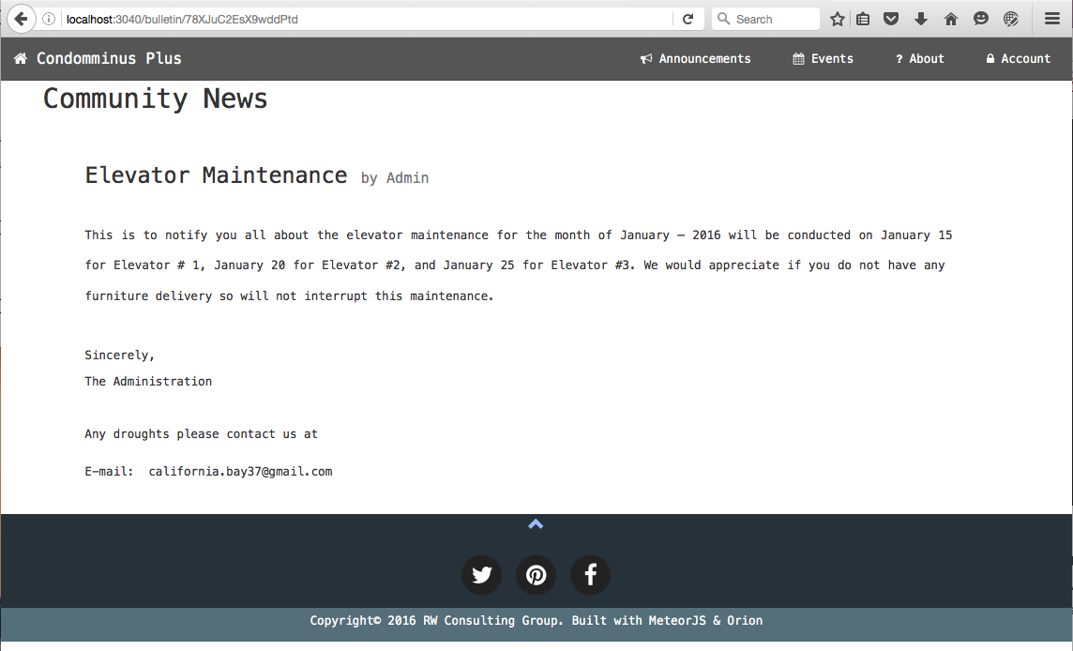
System: route /bulletin/:_id

Slide 8
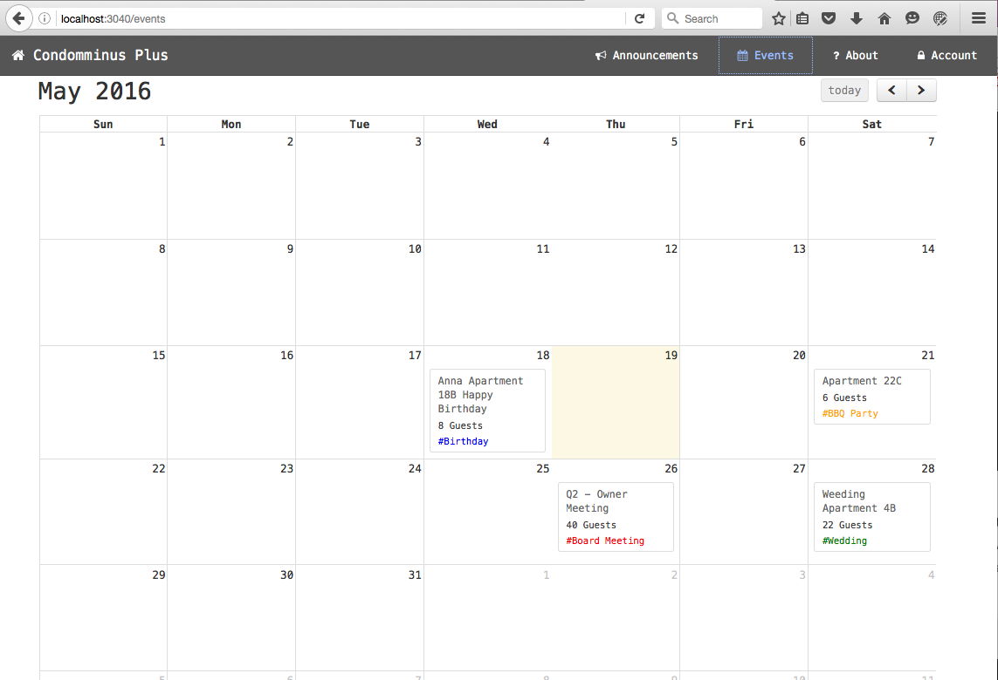
System: route /events

Slide 9
System: collections
Accounts
Post
Category
Dictionary
Support in OrionJS
Booking
Likes

Slide 10
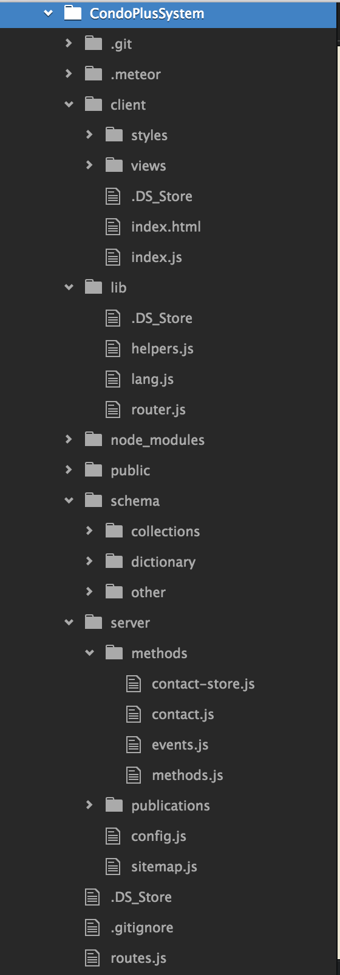
C System: files

Slide 11
Summary
The mission statement
3 key processes
System overview

